Slide 1
Symposium
Pullman Hotel Brisbane
23 November 2022

Slide 2
Opening Remarks: Gerard Byrne, ATCA Chair
Welcome to Country:
Aaron Martin,
Nunukal Yuggera, Aboriginal Dance Company

Slide 3
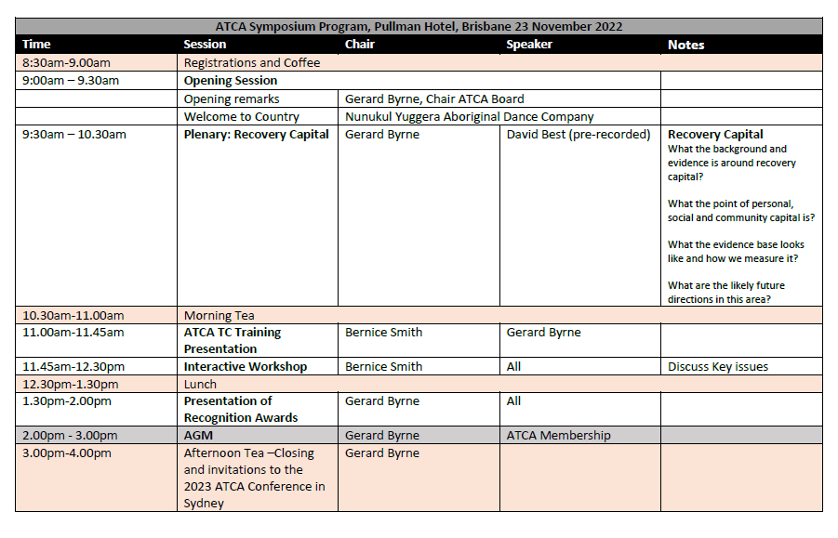

Slide 4
Recovery Capital David Best

Slide 5
Morning Tea
10.30am – 11.00am

Slide 6
ATCA TRAINING
Gerard Byrne

Slide 7
The ATCA TC Training Course was made possible by financial assistance provided by the
New Zealand Government and the
New Zealand Ministry of Health.
The initial development of the ATCA TC Training Course was undertaken by Matua Raki, the New Zealand National Addiction Workforce Development Body.

Slide 8
A Member Support and Workforce Development Initiative

Slide 9
Challenges exist in the recruitment, retention and most importantly training of TC staff
There are a range of factors that contribute to this situation for ATCA members:
COVID - 19
Wage pressure and competition
The jobs market
Suitable applicants
Lack of knowledge of TCs
An increasing gap between qualifications, knowledge, skills, expertise –
and the TC approach and role requirements
Notes:
COVID – Lockdowns, absenteeism, decreased service demand, changes to operations
Wage – Competing with government, increases to awards with limited funding increases
Job market – Record low unemployment, loss of overseas workers (due to COVID restrictions)
Suitable applicants – There is simply not enough suitable applicants to fill the positions that are vacant
No TC knowledge – TCs are a specialised model so most new staff need specific training
The gap – Due to low unemployment and lack of suitable applications the gap is widening

Slide 10
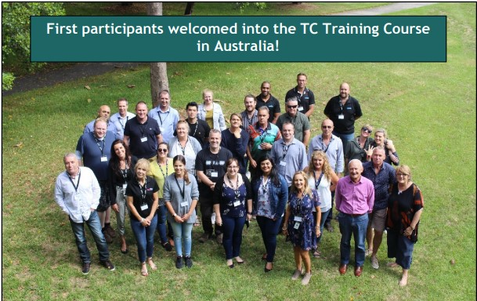
The first TC Training Course was delivered in New Zealand in 2017
The first Australian
ATCA TC Training Course
was held at
WHOS Sydney Campus in 2018
Thirty-four staff members from TCs based in NSW, ACT and Victoria
Since then, over 500 TC staff
have undertaken the
training course

Slide 11
The ATCA TC Training Course is comprised of seven modules, which are linked and are not suitable for, or available as, standalone learning options
48 hours of face-to-face – six modules, delivered in two block of three days
40 hour supervised practicum
20 hours self-directed learning
Online cultural competence training.

Slide 12
THE TRAINING COURSE TOPICS
Overview of the TC
Community As Method
TC Structure
Organisation and Environment
Relationships in a TC
Staff Roles, Responsibilities & Rational Authority
Group Work
TC Tools
Work as Therapy
Continuing Care
Supervised Practicum - Learning by Experience.

Slide 13
BLOCK 1 | TIME | SELF LEARING HOURS
Module 1. Course orientation; Overview of the TC | 1 day | 4
Module 2. Community-as-method | 1 day | 4
Module 3. TC structure, organisation and environment | 1 day | 2
BLOCK 2
Module 4. Relationships in a TC | 1 day | 2
Module 5. Staff roles and responsibilities and rational authority | 1 day | 4
Module 6. Group work; TC tools; work as therapy; continuing care | 1 day | 4
PRACTICUM
Module 7. Supervised practicum: learning by experience | 40
TOTAL | 88 | 20

Slide 14
Under review
Notes:
Resources include a facilitators manual, participant manual, presentation package, classroom resources, video presentations and lots of small and large group activities.

Slide 15
Notes:
Participants were asked to list three key takeaways from the training.
These results display the key outcomes of the training are being achieved, with participants reporting a positive training and learning experience.

Slide 16
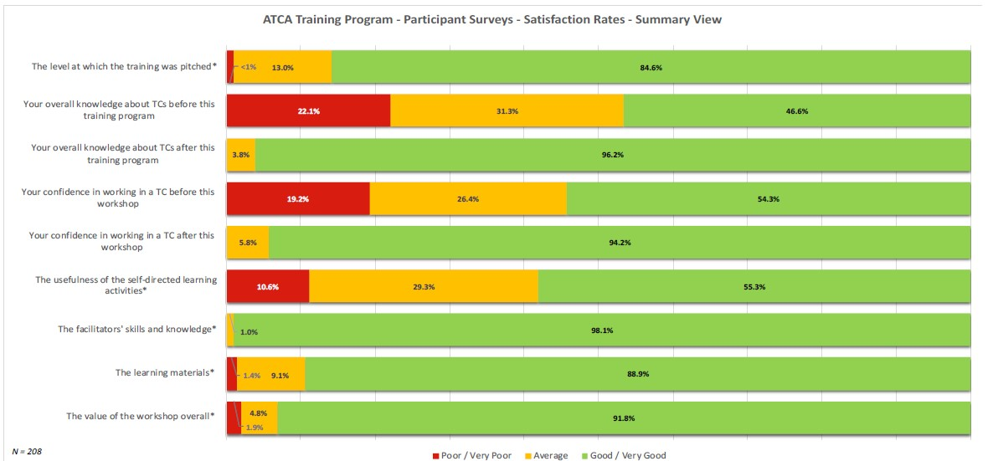
Notes:
The questions asked:
The level at which the training was pitched
Shows the training is being pitched to the right audience, in the right way – and mostly at the right time for their development.
Participants’ overall knowledge about TC’s before and after receiving training
Participants’ confidence in working in a TC before and after receiving training
This result shows the value of the training
Make general comments about the rest of the results below.
The usefulness of the self-directed learning activities
The facilitators’ skill and knowledge
The quality of the learning materials
The value of the workshop overall

Slide 17
Interactive Workshop session to discuss key issues
Chair: Bernice Smith
Objectives of the Session:
To give an update on the key issues that the ATCA Board have been working on
To share Topics from recent ATCA consultation
To enable Symposium Delegates to add to the Topics
To explore/share new innovative programs/processes etc.
Outcome of the session:
Symposium Delegates to be up to date with activities undertaken by ATCA re key issues facing the TC sector and the opportunity to input.
Outline of the session:
Introduction
Update of ATCA activities
Group activity - expand on issues
Summary

Slide 18
Presentation of Recognition of Service Certificates
30 or more years:
Carol Daws, Cyrenian House
10-20 years:
Christine Dewhurst, Windana
Mandy Sinclair, Windana
Suanne Fahy, Windana
Mark Hill, One80TC
Leigh Davidson, One80TC
Wendy Zani, Goldbridge
Mellissa Doran, Karralika
Nicki Esau, Karralika
Kelly Connell, Karralika
Joseph Tandl, Karralika
Sharon Tuffin, Karralika
Jodie Bailey, Karralika
Gert Volcschenk, Odyssey New Zealand

Slide 19
Presentation to
Lynne Magor-Blatch
and
Garth Popple

Slide 20
Lunch
12.30pm– 1.30pm

Slide 21
ATCA AGM
Chair: Gerard Byrne, ATCA Chair
Opening – ATCA Chair, Acknowledgement of Country
Apologies
Minutes from 2021 AGM
Presentation of Chair’s Report – Gerard Byrne ATCA Chair
Presentation of Auditors Report, and recommendation for appointment of Auditor 2022 – 2023 – Mark Ferry, ATCA Treasurer
Presentation of Executive Officer’s Report – Vanessa Dumbrell, ATCA Executive Officer\
Announcement of ATCA Board for 2022-23
Any other business
Next AGM – ATCA Conference, 2023
Meeting Close

Slide 22
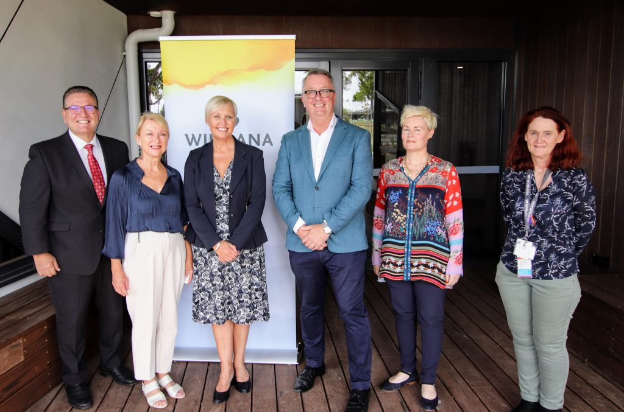
Windana
Member for Lara John Eren, Jenny Gillam Windana Chair, Andrea McLeod Windana CEO, Minister for Health Martin Foley, Clare Davies Windana Executive Director Rehabilitation Services, Robyn Horne-Herbig Windana Senior Trainer
Corio, Victoria

Slide 23
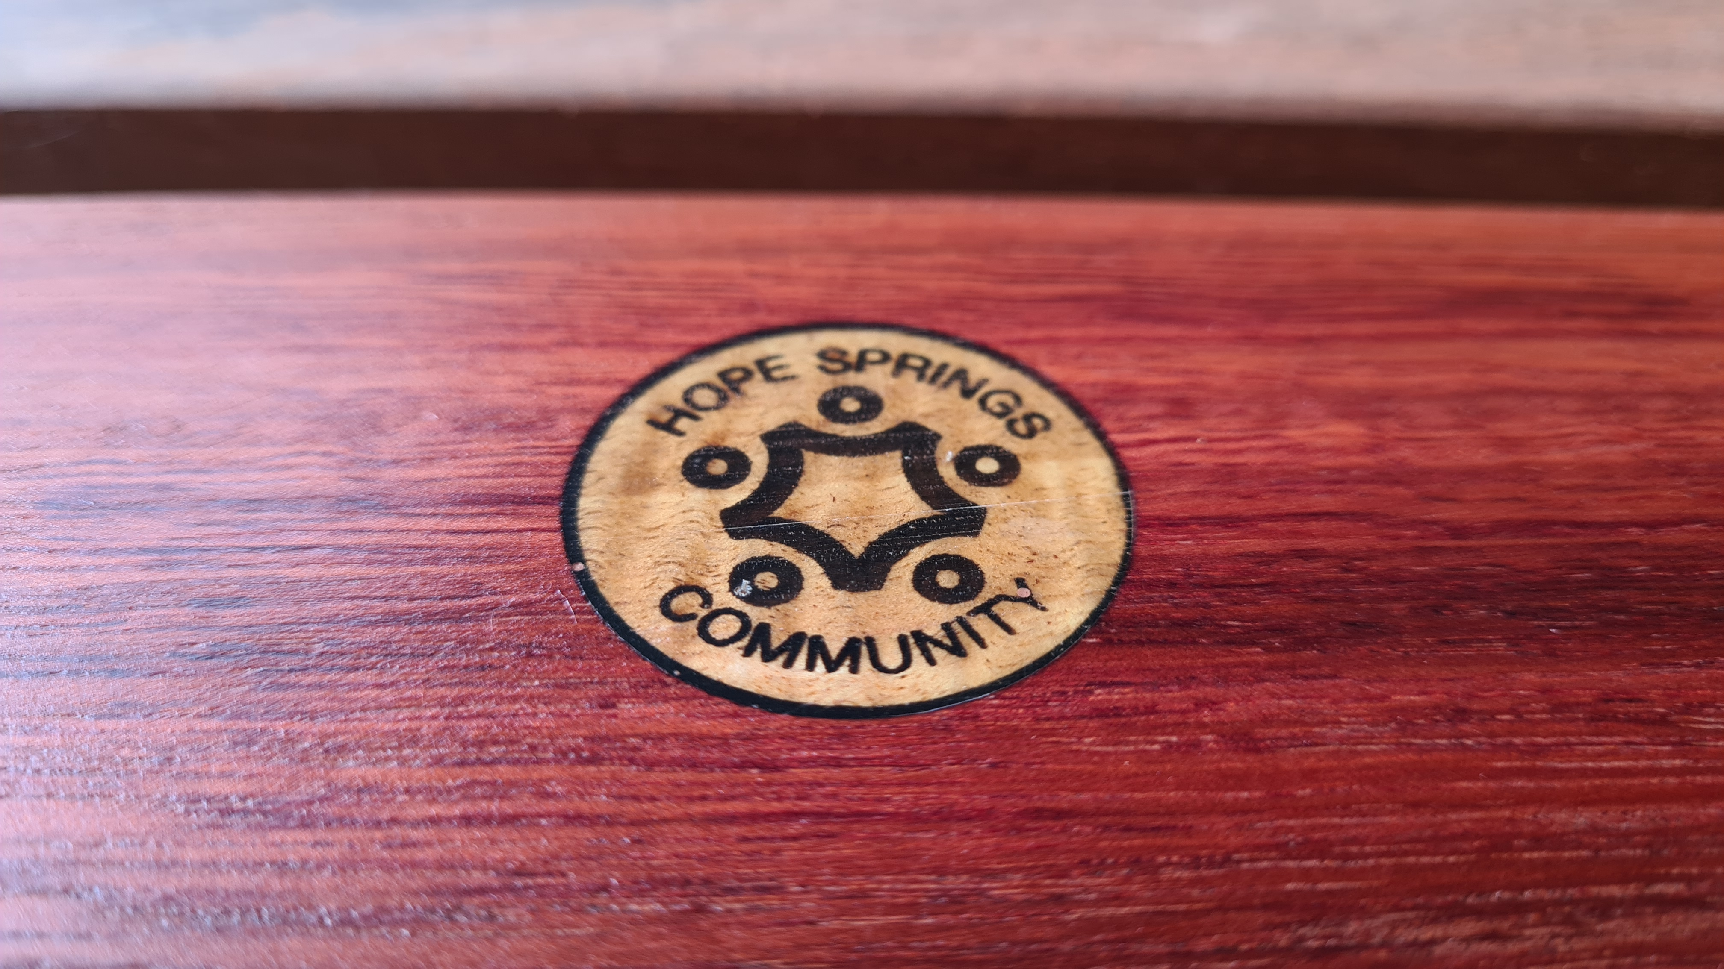
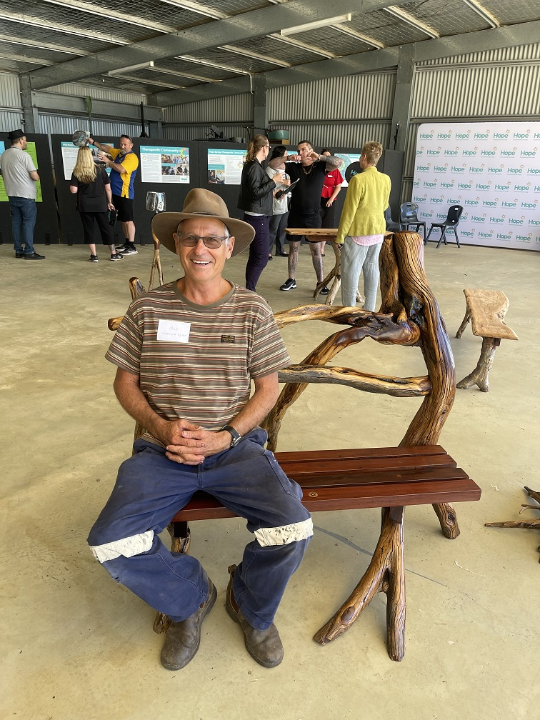
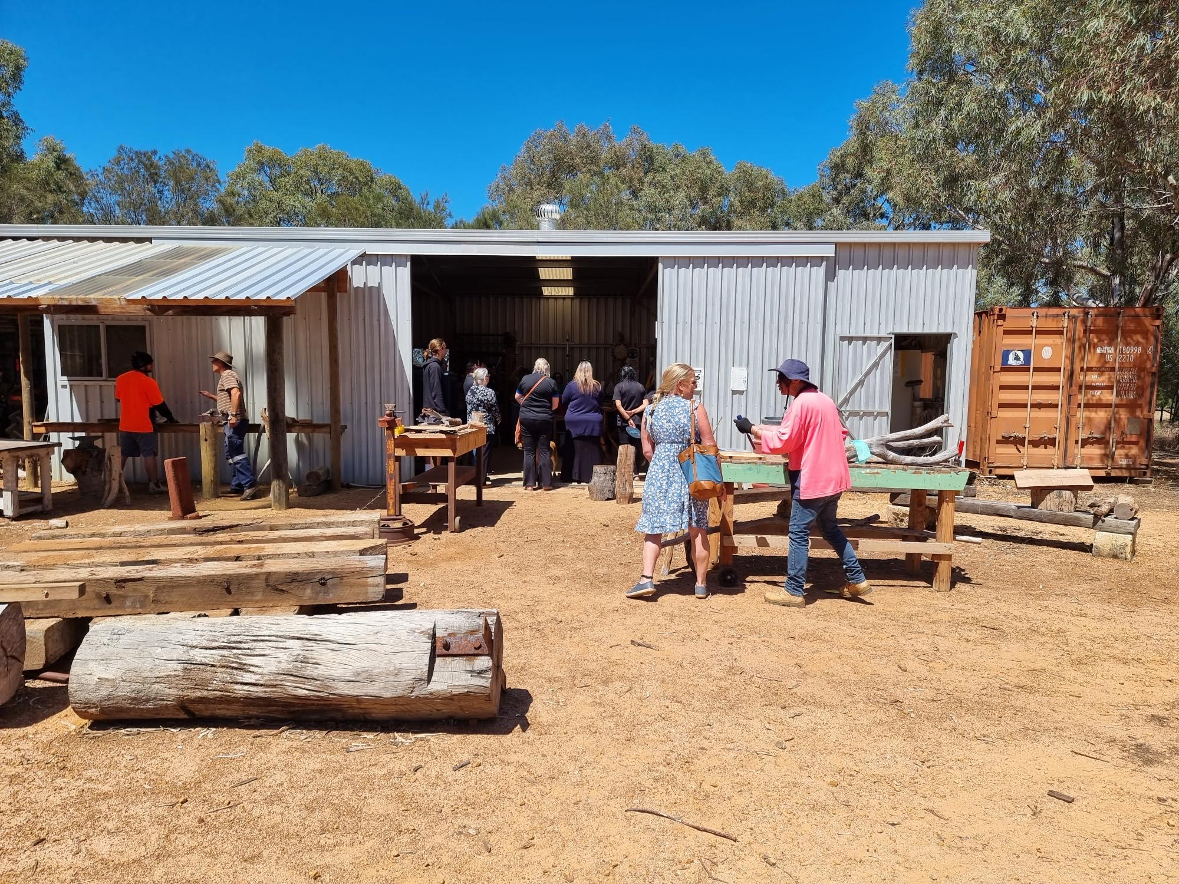
Hope Community Services
Woodworking Shed
Max – Woodwork teacher
Western Australia

Slide 24
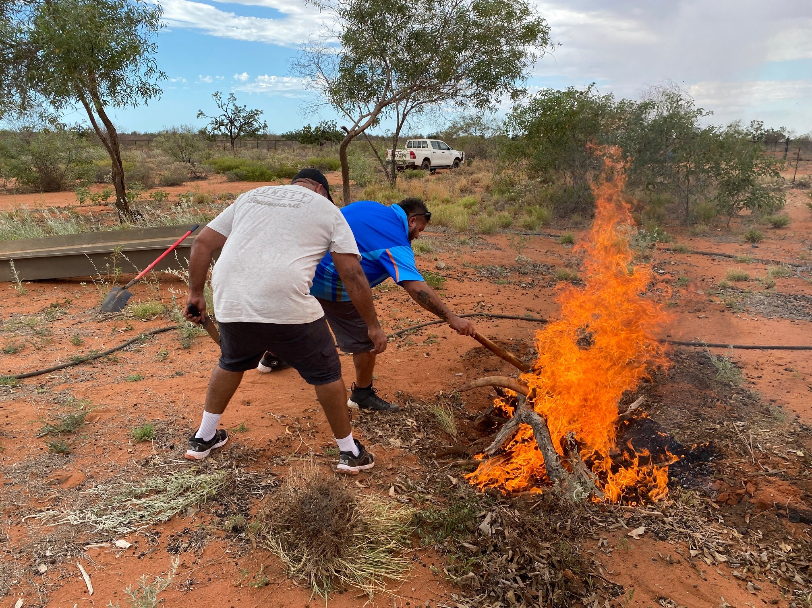
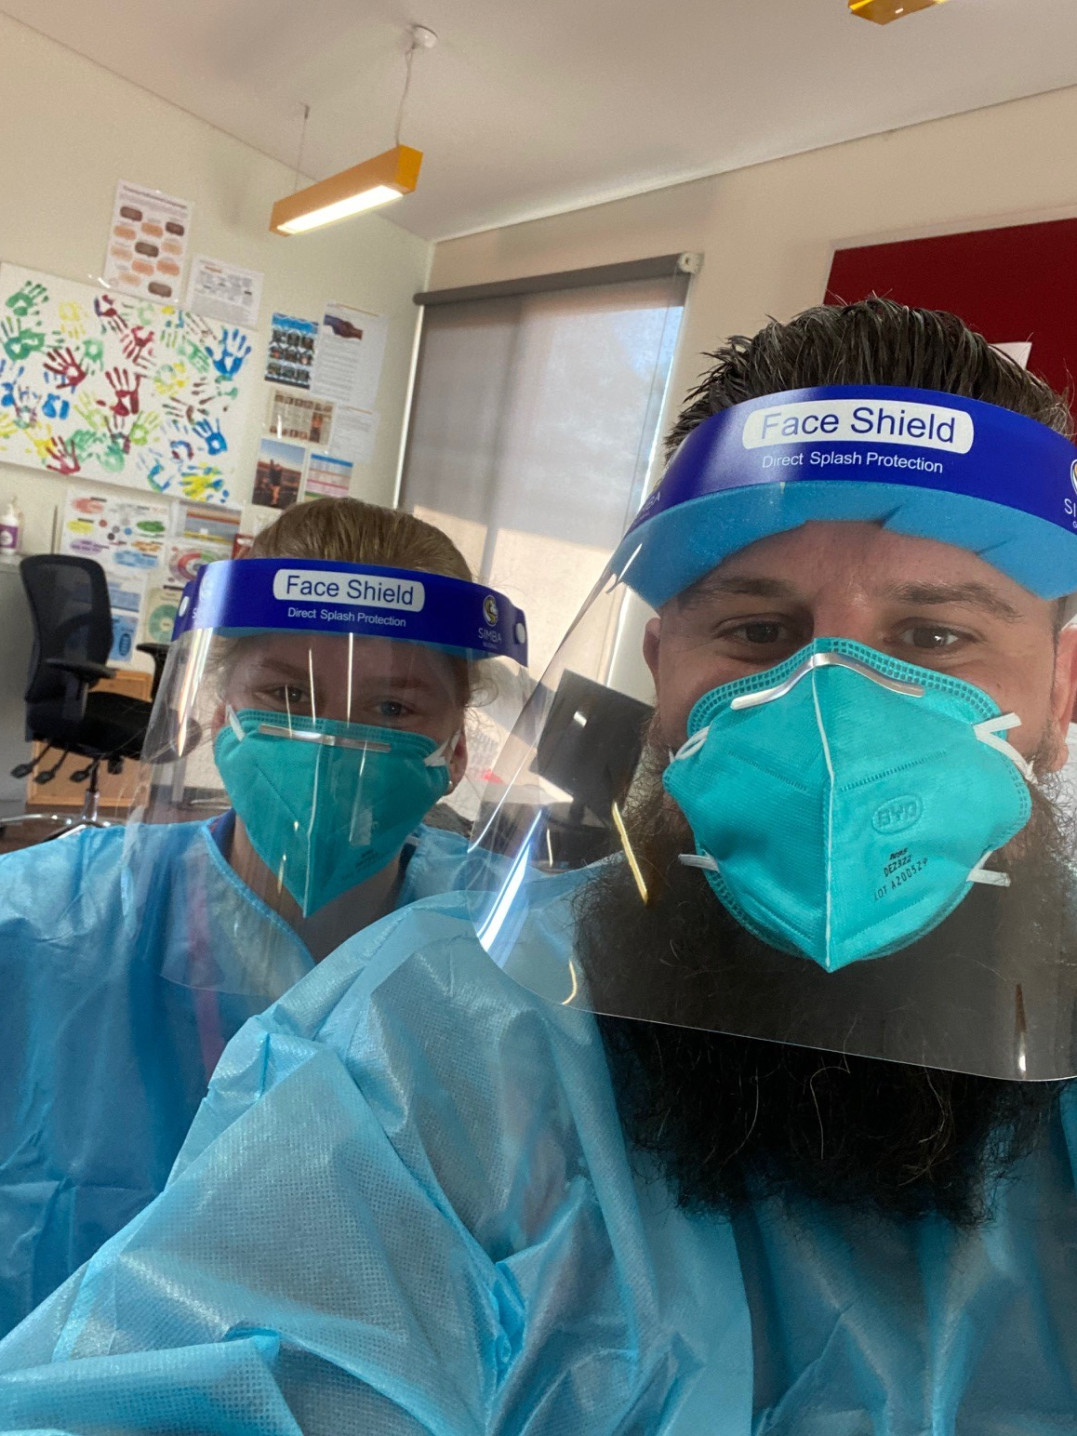
Yaandina
Yaandina staff in full PPE
Cooking Kangaroo Tails - Yaandina
Turner River

Slide 25
Closing Comments Afternoon Tea

Slide 26
Thank you to everyone for attending

